Slide 1
EV Remote Internship Project Report
Created by
THATHIREDDY HEMANTH,
Diploma & B.Tech (Final Year) Siddharth inst of Engg and Tech.
Puttur, AP.
Project name:
Nissan Leaf
Case Studies: FTP-75/MENDC/WLTP Drive Cycle

Slide 2
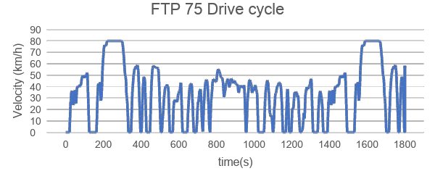
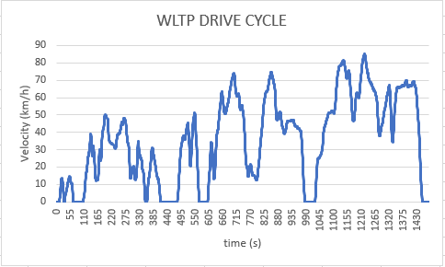
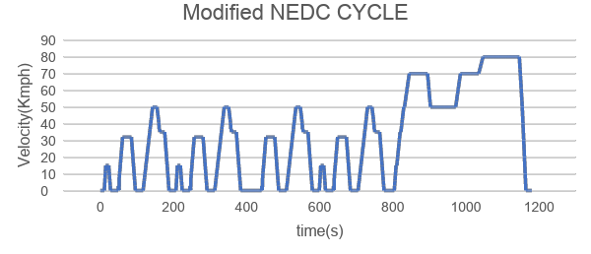
Drive Cycles
FTP-75 Drive Cycle
WLTP Drive Cycle
NEDC Drive Cycle

Slide 3
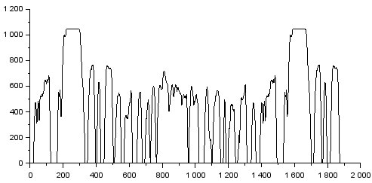
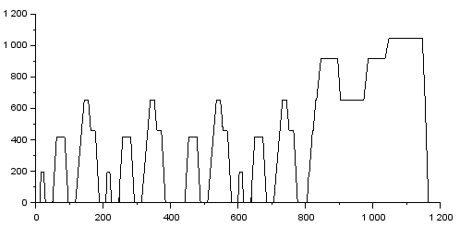
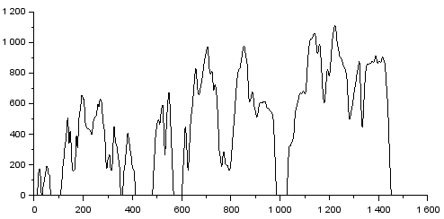
Wheel Speed for different Drive Cycles
FTP-75 Drive Cycle
MNEDC Drive Cycle
WLTP Drive Cycle
Maximum Speed =1044.323 | Maximum Speed = 1044.323 | Maximum Speed =1112.204
Average Maximum Speed = 1066.95 rpm

Slide 4
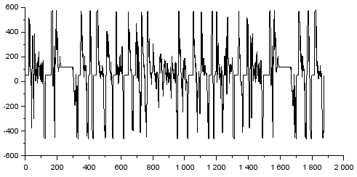
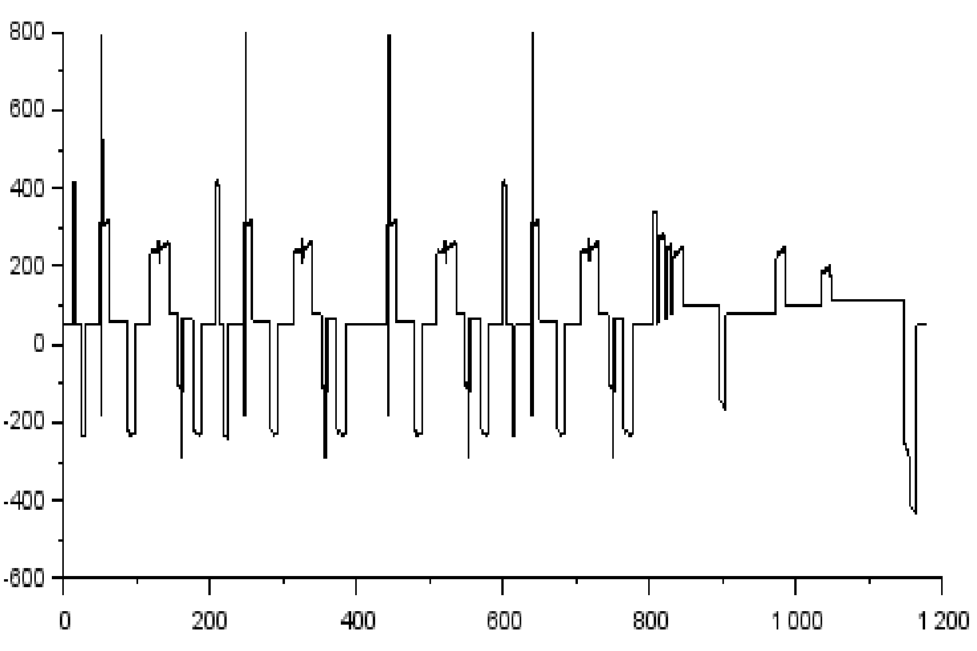
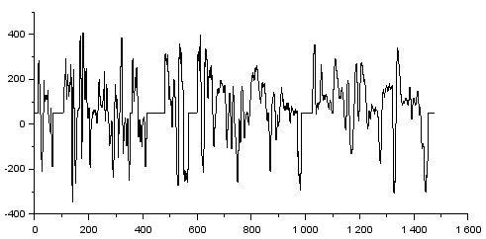
Wheel Torque for different Drive Cycles
FTP-75 Drive Cycle
MNEDC Drive Cycle
WLTP Drive Cycle
MaximumTorque = 582.423 | MaximumTorque = 795.298 | Maximum Torque = 407.723
Average Maximum Torque = 595.148 Nm

Slide 5
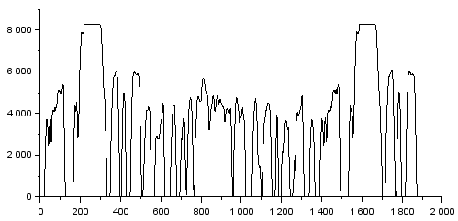
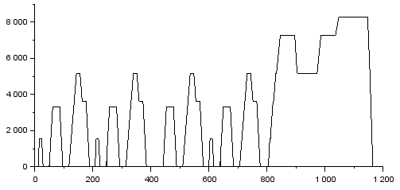
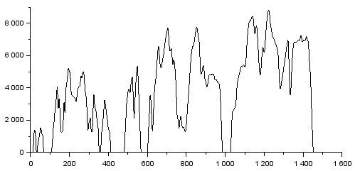
Motor Speed for different Drive Cycles
FTP-75 Drive Cycle
MNEDC Drive Cycle
WLTP Drive Cycle
Maximum Speed = 8289.528 | Maximum Speed = 8289.528 | Maximum Speed = 8828.348
Average Maximum Speed = 8469.134 rpm

Slide 6
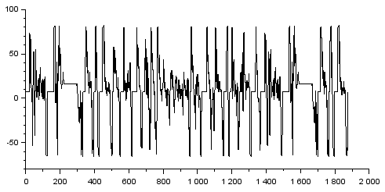
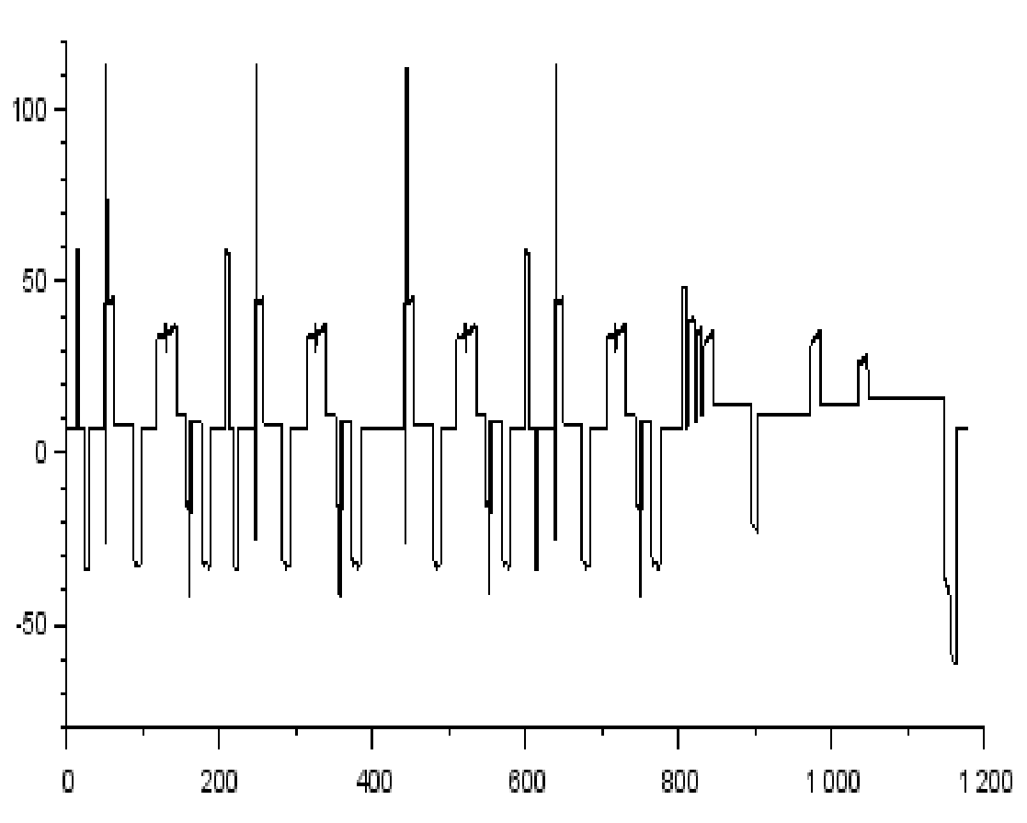
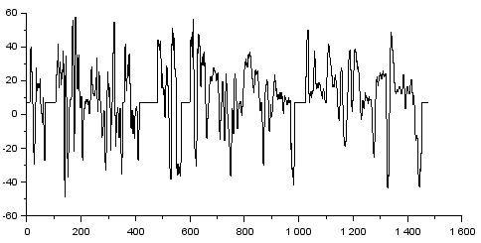
Motor Torque for different Drive Cycles
FTP-75 Drive Cycle
MNEDC Drive Cycle
WLTP Drive Cycle
Nominal Torque = 82.443 | Nominal Torque = 122.575 | Nominal Torque = 57.713
Average Nominal Torque = 87.577Nm

Slide 7
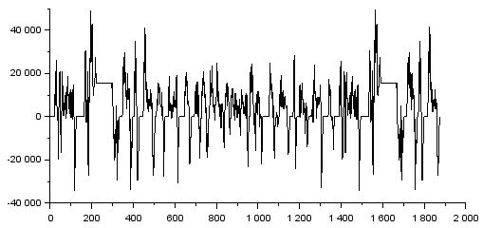
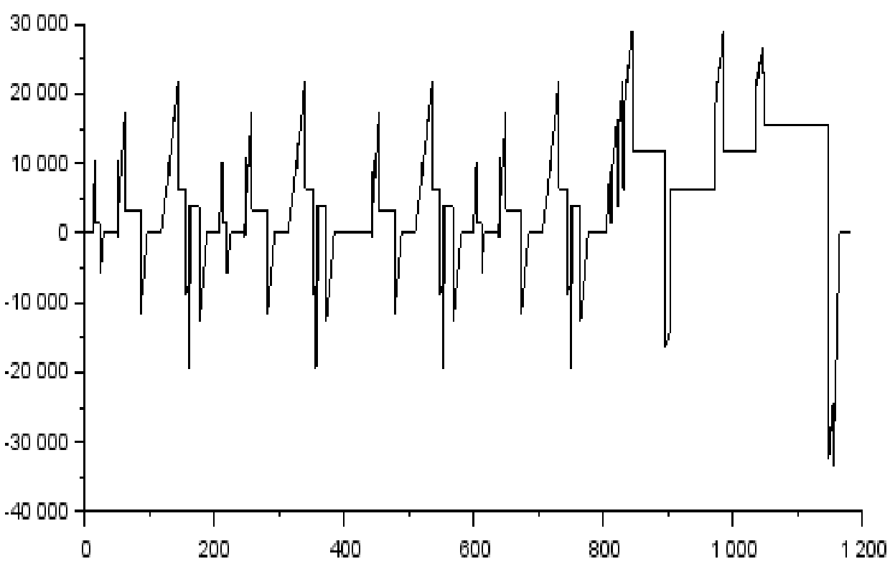
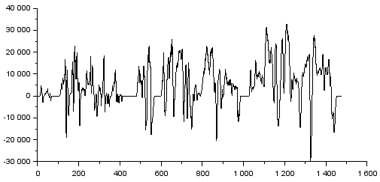
Motor Power for different Drive Cycles
FTP-75 Drive Cycle
MNEDC Drive Cycle
WLTP Drive Cycle
Nominal Power = 49242.261 | Nominal Power = 29009.221 | Nominal Power = 32949.172
Average Nominal Power = 37066.755W

Slide 8
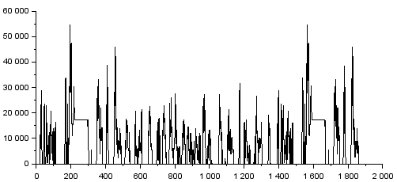
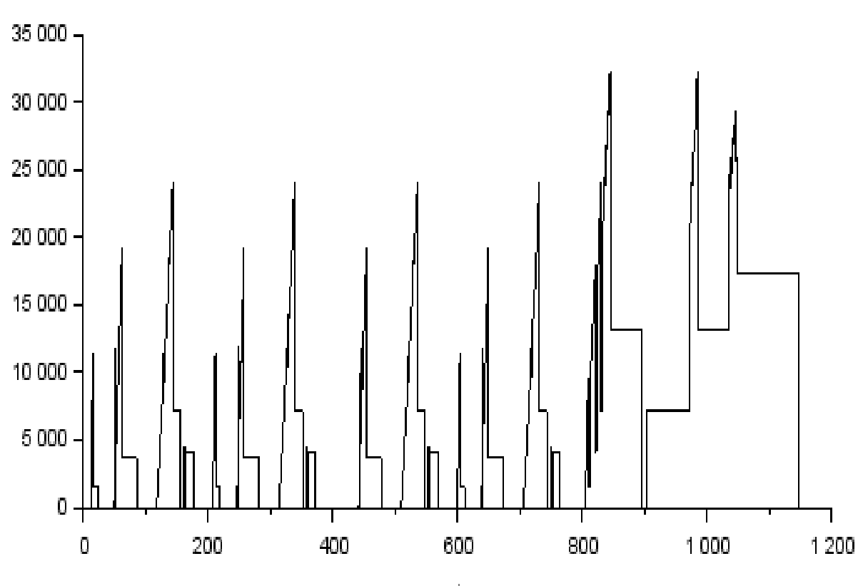
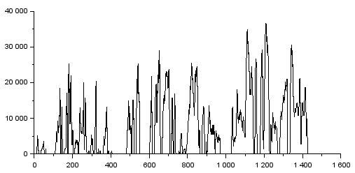
Battery Power for different Drive Cycles
FTP-75 Drive Cycle
MNEDC Drive Cycle
WLTP Drive Cycle
Nominal Power = 54713.62436610 | Nominal Power = 32232.468 | Nominal Power = 36610.191
Average Nominal Power = 41185.427 W

Slide 9
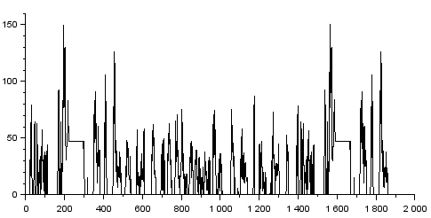
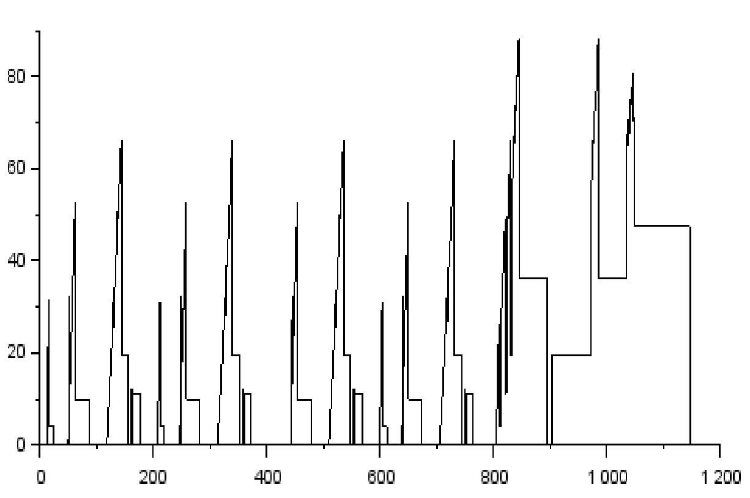
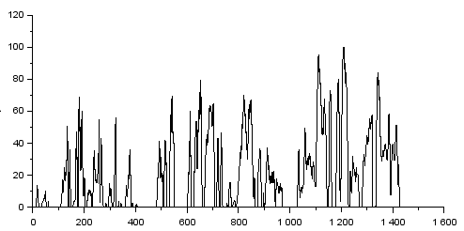
Battery Current for different Drive Cycles
FTP-75 Drive Cycle
MNEDC Drive Cycle
WLTP Drive Cycle
Nominal Current = 149.982 | Nominal Current =88.356 | Nominal Current = 100.356
Average Nominal Current = 122.898 A

Slide 10
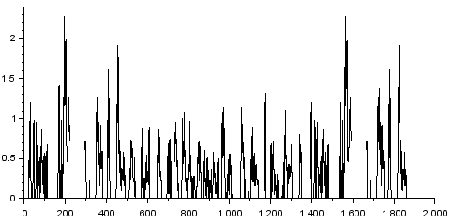
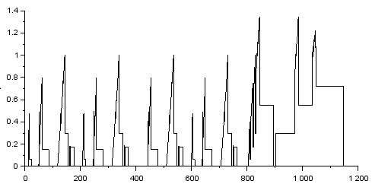
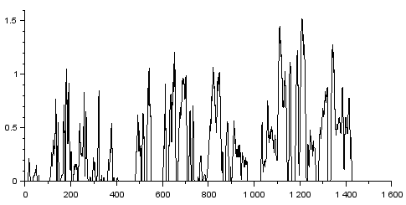
Battery Dischaarge C-Rate for different Drive Cycles
FTP-75 Drive Cycle
MNEDC Drive Cycle
WLTP Drive Cycle
Nominal Dischaarge C-Rate = 2.279 | Nominal Dischaarge C-Rate = 1.342 | NominalDischaarge C-Rate = 1.525
Average Nominal Dischaarge C-Rate = 1.715 C

Slide 11
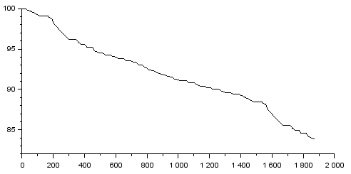
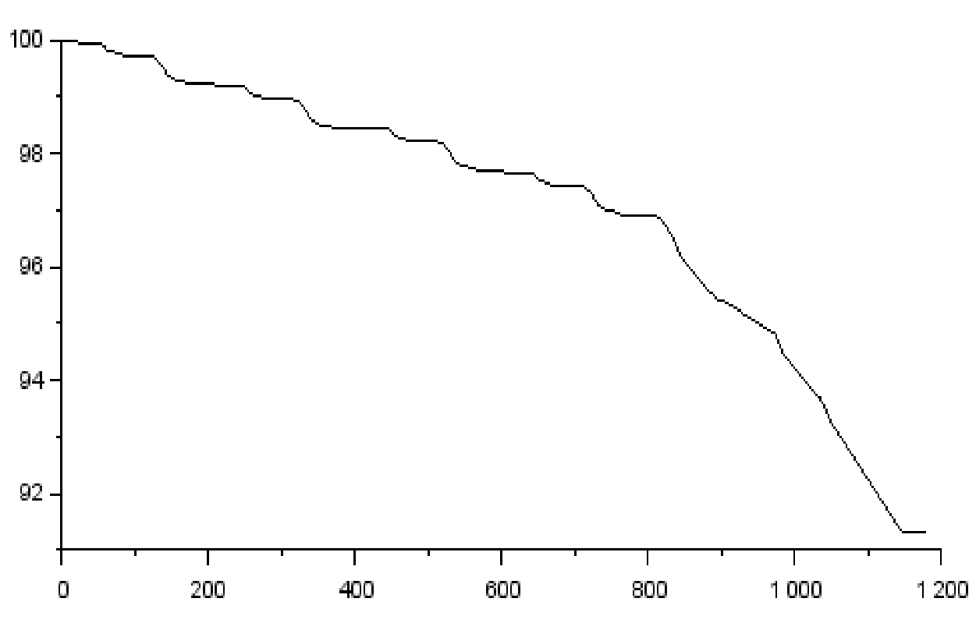
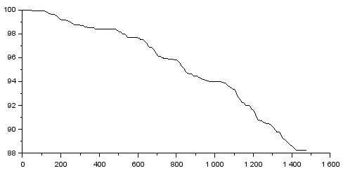
SOC for different Drive Cycles
FTP-75 Drive Cycle
MNEDC Drive Cycle
WLTP Drive Cycle
State of Charge = 83.905 | State of Charge = 91.916 | State of Charge = 88.25
Average Nominal Torque = 88.023%

Slide 12
Range for different Drive Cycles
FTP 75 | MNEDC | WLTP
108.7km | 118.3 km | 124.9km

Slide 13
Thank you
Email-id : hemanthandprakash@gmail.com
Mobile no.: 7093625879

